Slide 1

AWS Fundamentals

Slide 2
Agenda
8:30am – 9:00am: Check-in
9:00am – 12:00pm: AWS Basecamp Basecamp Introduction Introduction to Cloud Computing
AWS Services and Regions Overview AWS Networking
VPC - Route 53 AWS Security Overview AWS Compute
EC2 – ELB - ASG
AWS Storage
EBS - S3 - Glacier AWS Databases
RDS – DynamoDB - Redshift
12:00pm – 1:00pm: Break & Lunch
1:00pm – 3:00pm: Hands-On Lab - Building AWS Infrastructure
2

Slide 3
Basecamp Introductions
Name: Company: Title/Work Area:
8

Slide 4


Introduction to Cloud Computing

Slide 5
New IT Business Model
Cloud Computing is first and foremost a
Business Model

Slide 6
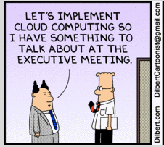




Business Reasons for Adopting Cloud Computing
Not Good
Good
Move from capital expense to variable expense
$
Increased agility
Lower variable expense than they could achieve on their own
Stop guessing capacity
Remove undifferentiated heavy lifting
Go global in minutes

Slide 7





What is Cloud Computing?
NIST 5 Key Characteristics
#1 On-demand self service
“as easy as buying candy from a vending machine”
#5 Measured service
“pay only for what you consume”
#2 Broad network access
“access it anytime from anywhere”
#4 Rapid elasticity
“scale up and scale down in real-time”
#3 Resource pooling
“you’re not the only user”

Slide 8
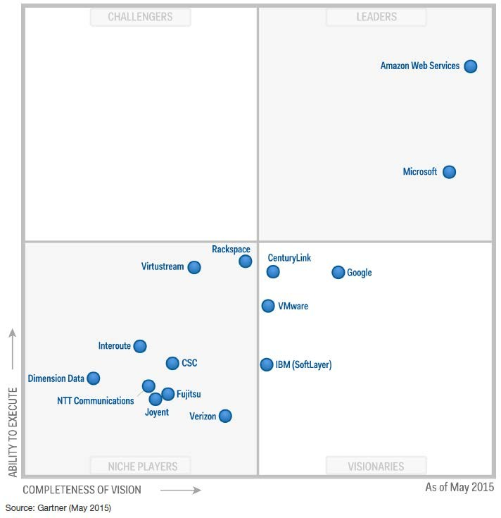
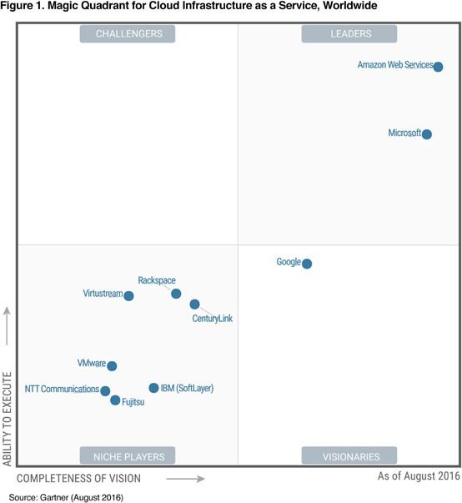
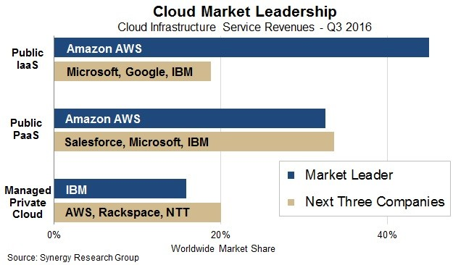
Public cloud market share
AWS Today - 2019
Amazon Web Services: 45%
per Synergy Research Group
AWS generating > $12 billion a year.
“It is the overwhelming market share leader, with over 10 times more cloud IaaS compute capacity in use than the aggregate total of the other 14 providers in this Magic Quadrant” Gartner Report May, 2015.

Slide 9
AWS Services and Regions Overview

Slide 10

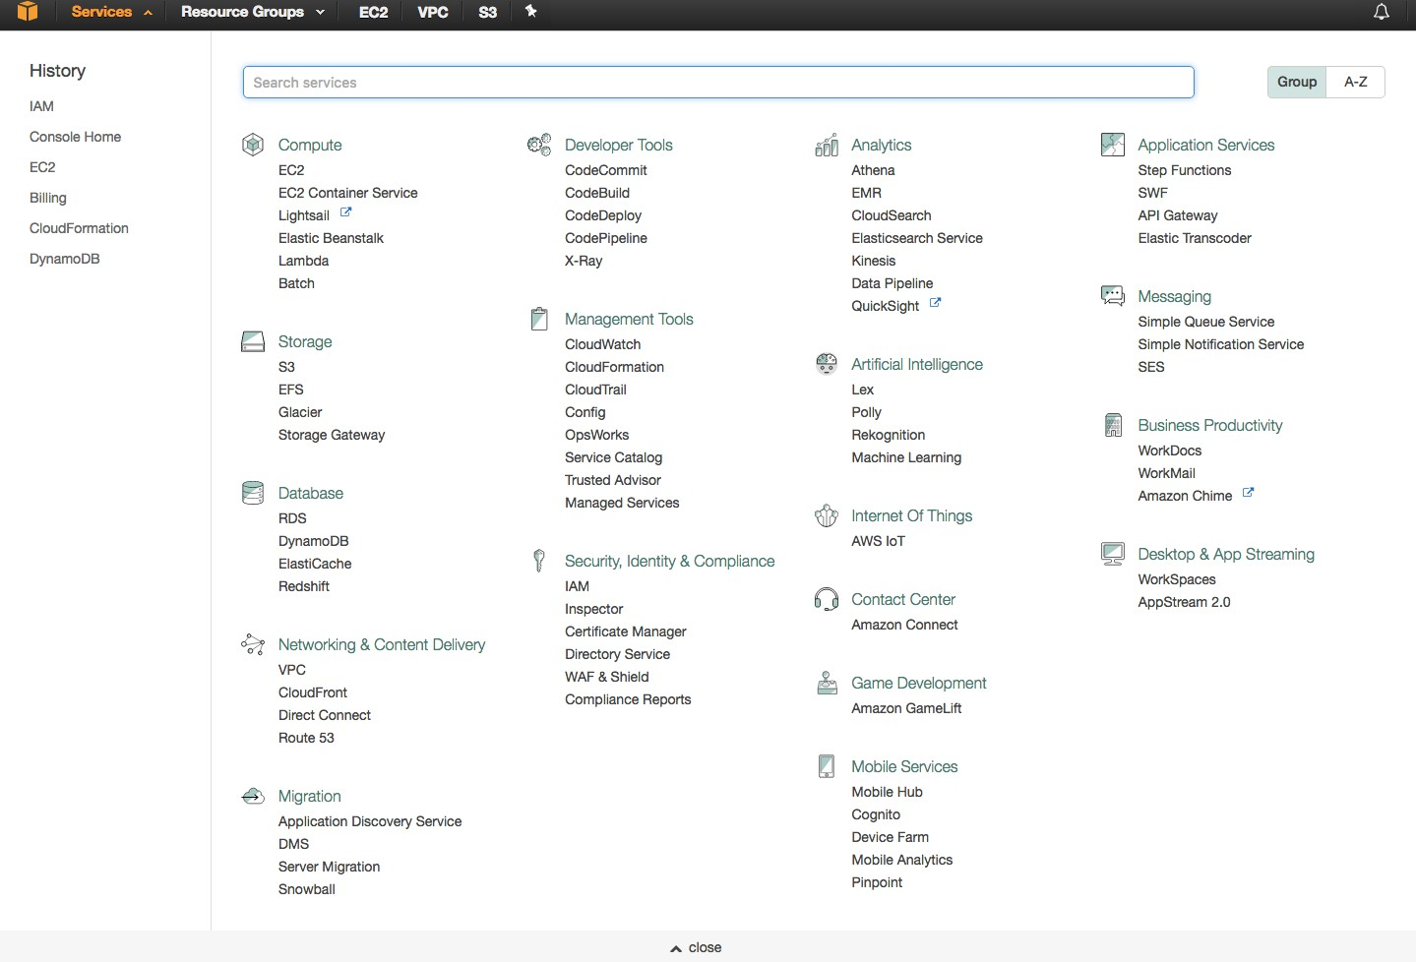
AWS Services

Slide 11
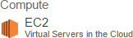
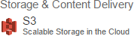
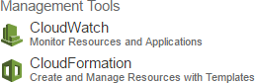
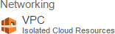
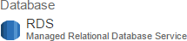
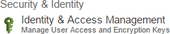
Core Services

Slide 12
What are we learning today? Load balanced Website
AZ = physical data center
VPC = virtual data center
EC2 Instance = virtual machine, VMs
Security Group = firewall
AMI = gold image

Slide 13
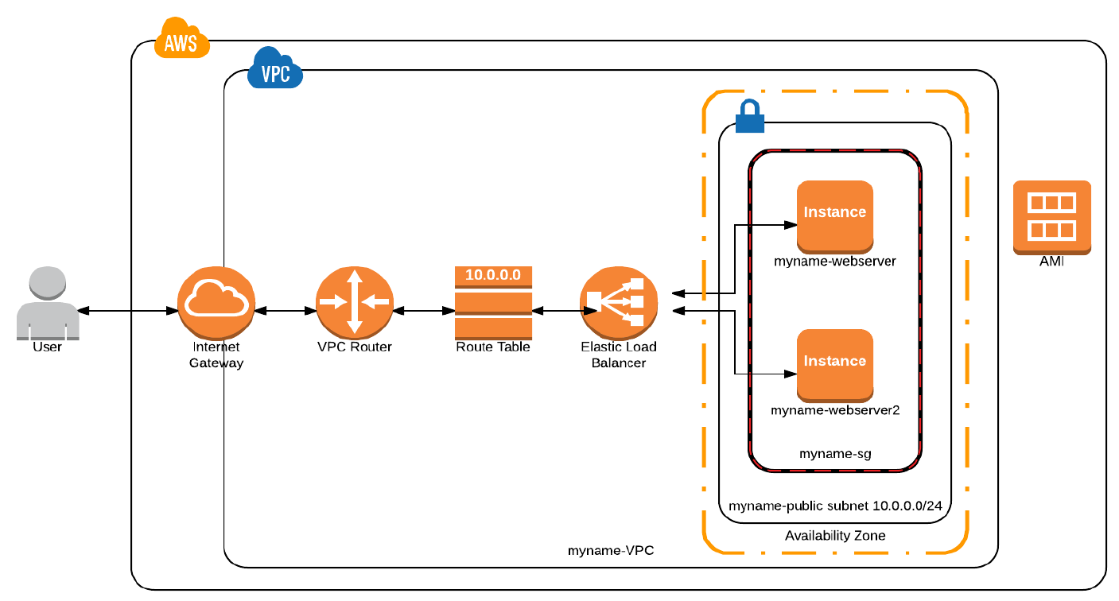

Slide 14
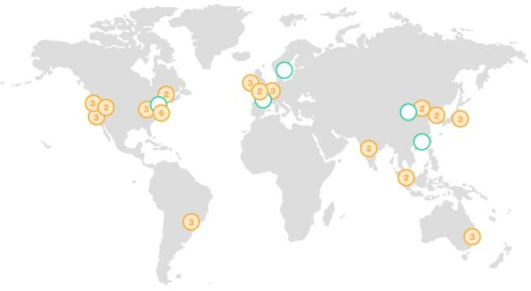
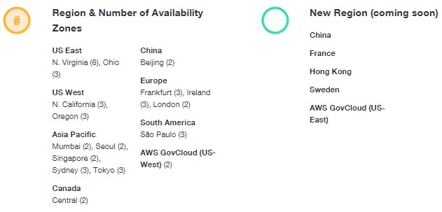
AWS Regions – Global Infrastructure

Slide 15
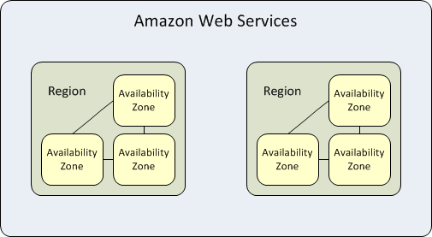
Regions and Availability Zones
Global Resources
» IAM Users
» Route 53 Records
Regional Resources
» S3 Buckets
» VPCs
» ELB
AZ Resources
» EBS Volumes
» EC2 Instances
» RDS Instances
» Subnets

Slide 16
AWS Networking Overview

Slide 17
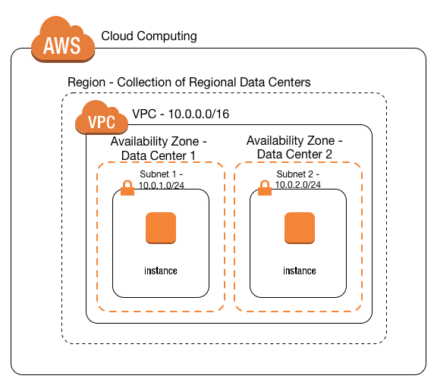

VPC - Virtual Private Cloud Overview
“Your Virtual Datacenter in the Cloud”
Essential Components:
Subnets
Route Tables
Network ACLs
Security Groups
Internet Gateways
NAT Gateways
Virtual Private Gateways

Slide 18
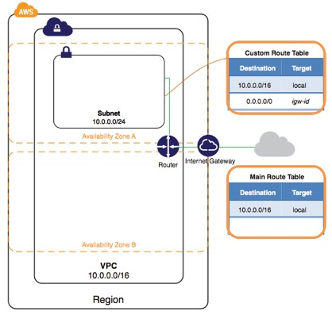
VPC - Subnets

Slide 19
VPC – Network and Subnets
Network Topology
Private address space
Any range is valid, but we suggest a non-routable CIDR
Public CIDR ranges are only reachable via a Virtual Private Gateway
CIDR ranges can be as large as a /16 to as small as a /28
Subnets
Public subnets have a 0.0.0.0/0 route to the Internet Gateway (IGW)
Instances that require a public IP need to reside in a public subnet
Private subnets do not have an outbound route through the IGW
NAT instances are commonly used as an outbound gateway for private instances
Subnets cannot span AZ’s, but can share routing tables, which provides similar functionality.

Slide 20
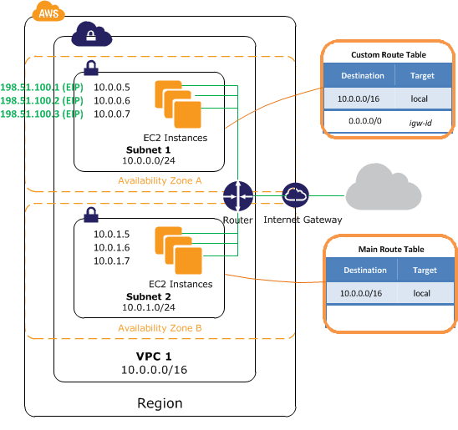
VPC – Route Tables
Route Tables
Can be applied to multiple subnets
Typical routing entries
10.0.0.0/16 = Local
0.0.0.0/0 = Internet Gateway (Public Subnet)
-or-
0.0.0.0/0 = eni-12345678 (Private Subnet)

Slide 21
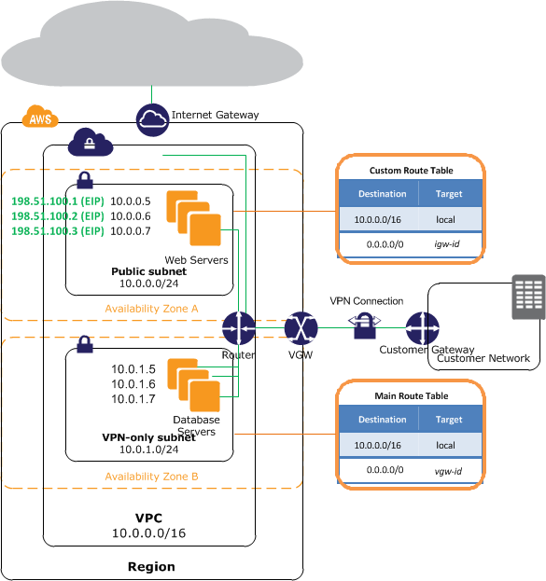
VPC – Bringing it Together

Slide 22
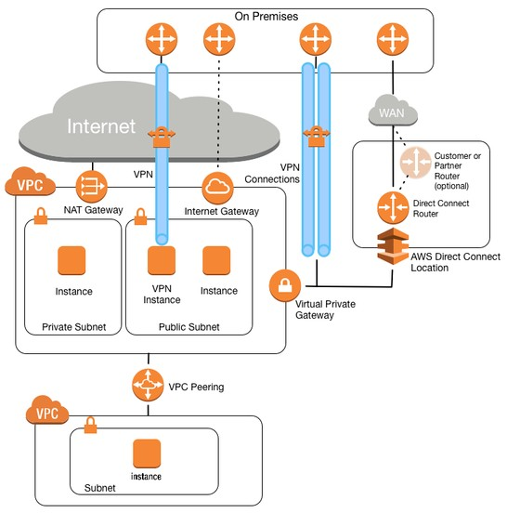
VPC – On-Premises Connection

Slide 23

Route53 - Basic Feature Set
Zone Creation
Zone Import
Import your zone file from a previous provider
Delegate this zone to the AWS name servers
Record Types
A
CNAME
TXT,MX
Alias
S3 buckets and ELBs can be an alias target, allows zone apex magic

Slide 24
Route53 - Advanced Feature Set
Weighted Resource Record Sets
Health Checks
Global Load Balancer
Using weighted record sets, you can create a pool of endpoints from which to balance traffic
Enabling a health-check on this pool allows for a DNS based
load balancer which can be applied to any resource (AWS or non-AWS)
Latency Resource Record Sets
Geolocation Resource Record Sets

Slide 25


Route53 – Global Failover
myapp.example.com
Route 53
Global Failover Pattern
Uses R53 Health Checks
Virginia Region
Ireland Region

Slide 26

AWS Security Overview

Slide 27



Security and Compliance – Shared Security Model
Customers
Customer content
Customers are responsible for their security IN the Cloud
Platform, Applications, Identity & Access Management
Operating System, Network & Firewall Configuration
Client-side Data Encryption
Server-side Data Encryption
Network Traffic Protection
AWS Foundation Services
Compute Storage
AWS is responsible for the security OF the Cloud
Database
Networking
AWS Global Infrastructure
Availability Zones
Edge Locations
Regions

Slide 28



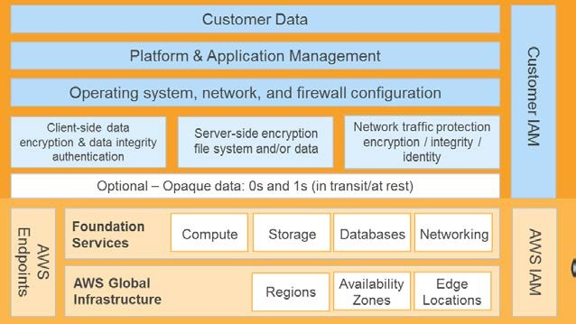
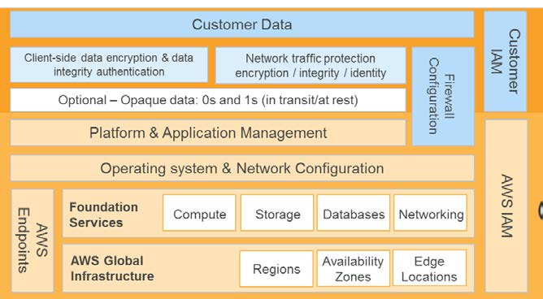
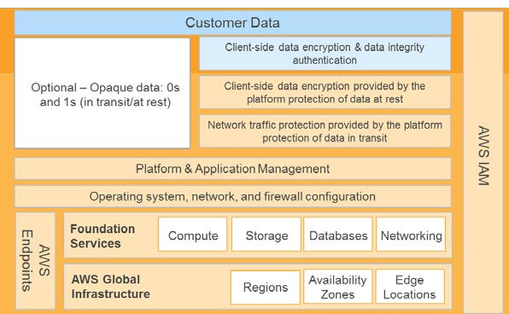
Shared Responsibility Model is not Static
Can shift or differ based on technology, business purpose, architecture
Infrastructure Services
Container Services
Abstracted Services

Slide 29
Current vs AWS
Network ACLs = access control lists
Security group = firewall
CloudTrail = audit tool
IAM = Active Directory

Slide 30
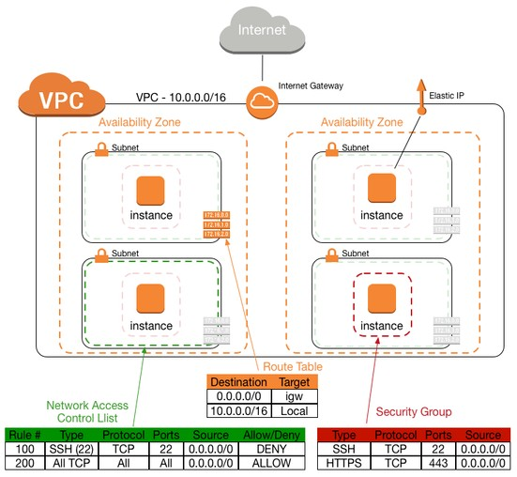
Network ACLs
Behavior:
Allow/Deny traffic at the subnet level
Stateless
Default is Allow All
Pro – further defines permissible traffic
Con – adds complexity and can complicate troubleshooting

Slide 31
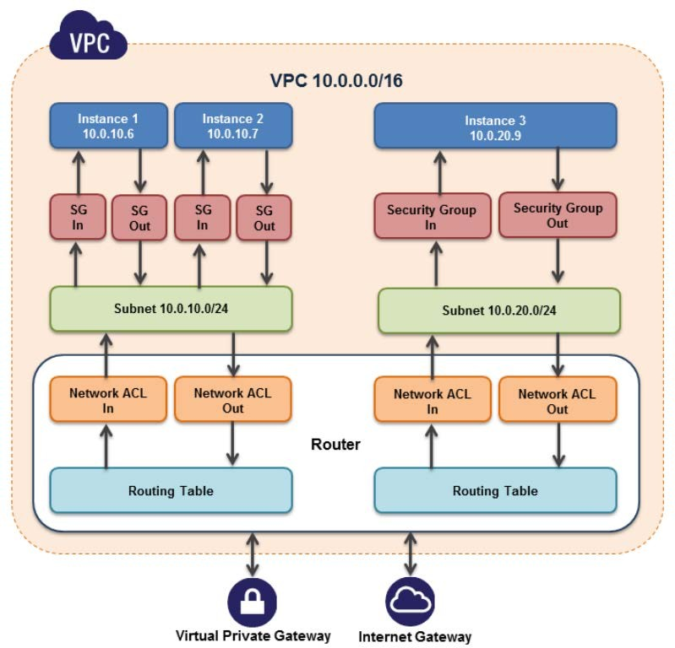
Security Group Behavior
Work at instance level
Stateful
Deny by default
IP Whitelisting (CIDR)
Allow port and protocol
Can allow TCP, UDP, ICMP or a combination of all three
SG Trust Relationships
Scoped to the VPC

Slide 32





Security Group/Firewall Rules
Client Ingress
SID_View_Ingress
Protocol | Port Range | Source
TCP | 80 | 10.12.0.0/16
TCP | 80 | 10.45.2.0/24
TCP | 80 | 10.62.31.0/24
View Firewall Policies SID_View_Ingress SID_Admin_Ingress
VIEW
SSH and RDP Ingress
SID_Admin_Ingress
Protocol
Port Range
Source
SID View
TCP
22
10.99.101.0/24
TCP
3389
10.99.101.0/24
 | SID_App_Ingress
Platform Server Ingress | Protocol | Port Range | Source
 | TCP | 80 | 10.241.25.0/24
 | TCP | 443 | 10.241.25.0/24
 | TCP | 8080 | SID_VIEW_SG
App Firewall Policies SID_App_Ingress SID_Admin_Ingress SID_App_Egress
APP
SID App
Platform Server Egress
SID_App_Egress
Protocol | Port Range | Destination
TCP | 443 | 10.87.14.29/32
TCP | 3306 | 10.24.3.102/32
Database Firewall Policies
SID_DB_Ingress
Database Access
SID_DB_Ingress
Protocol | Port Range | Source
TCP | 3306 | SID_APP_SG
SID Database

Slide 33

CloudTrail
Record of API requests and response elements
who did what and when, from where
Identity
Time
Source
Parameters
Response

Slide 34
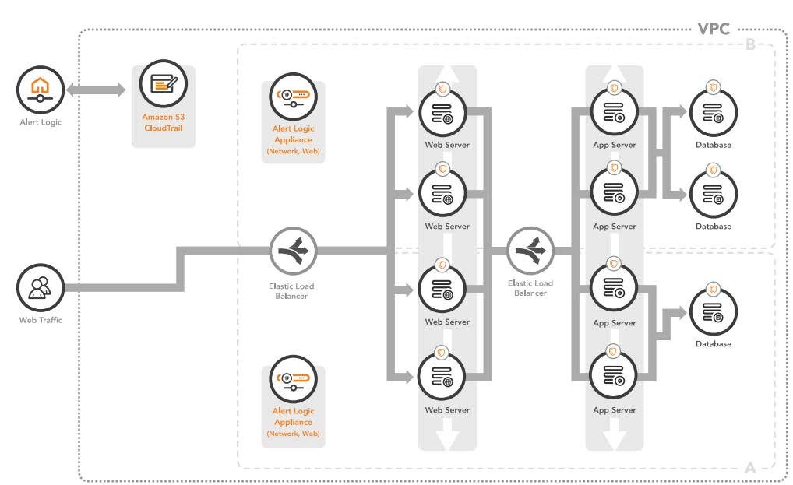
Alert Logic® Cloud Defender™

Slide 35
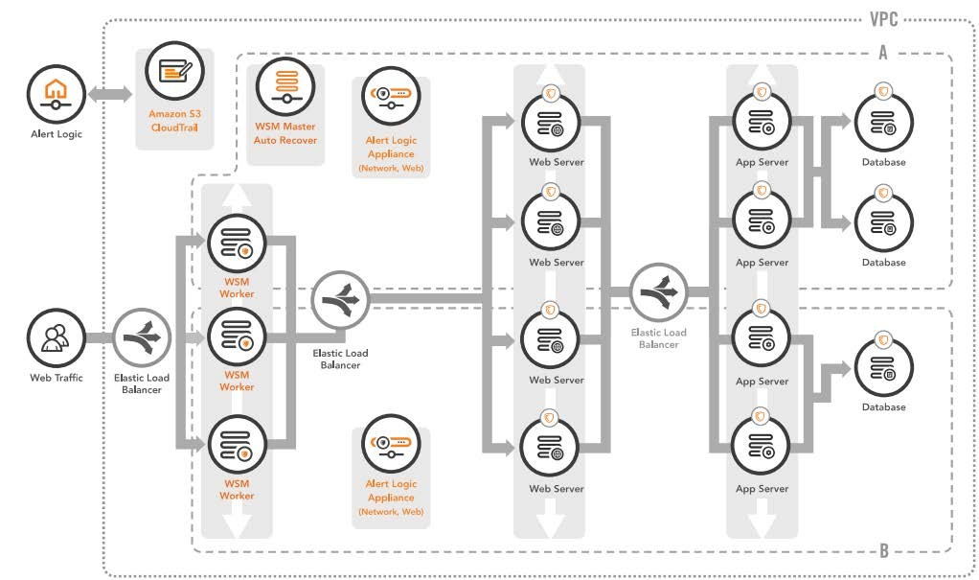
Alert Logic® Cloud Defender™
+ Web Security Manager Premier

Slide 36


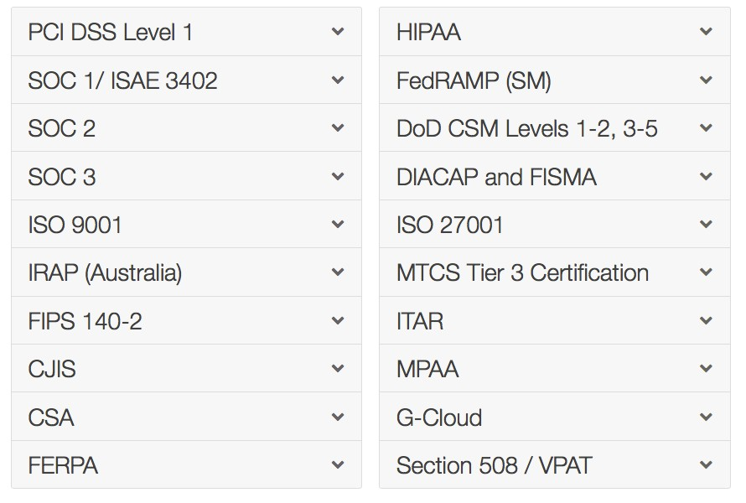




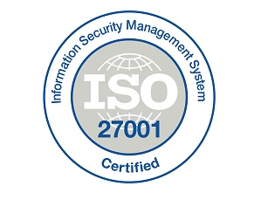
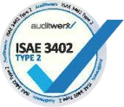


AWS Compliance
Certificates
Programs

Slide 37
Identity & Access Management

Slide 38
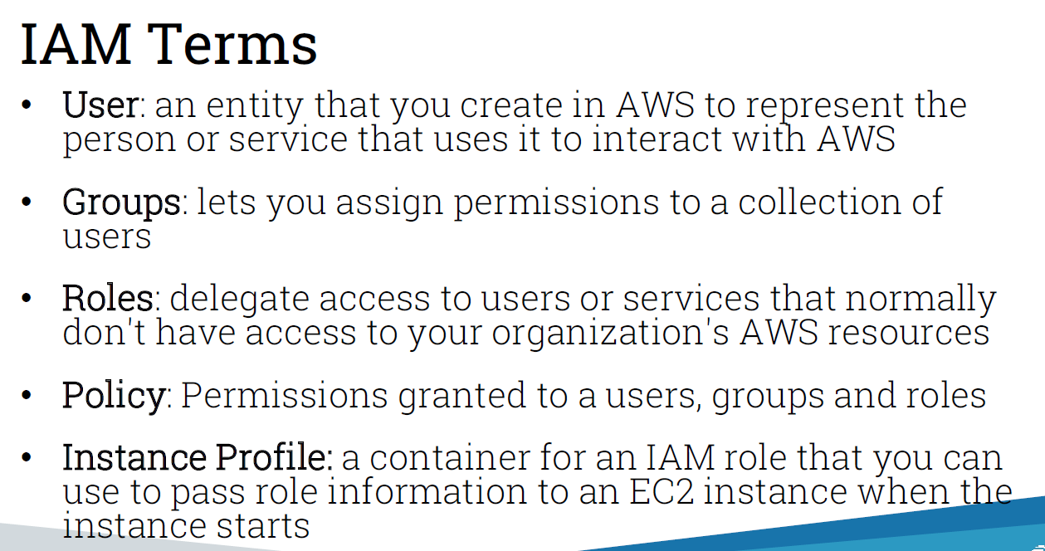
IAM Terms
User: an entity that you create in AWS to represent the
person or service that uses it to interact with AWS
Groups: lets you assign permissions to a collection of users
Roles: delegate access to users or services that normally don't have access to your organization's AWS resources
Policy: Permissions granted to a users, groups and roles
Instance Profile: a container for an IAM role that you can use to pass role information to an EC2 instance when the instance starts

Slide 39
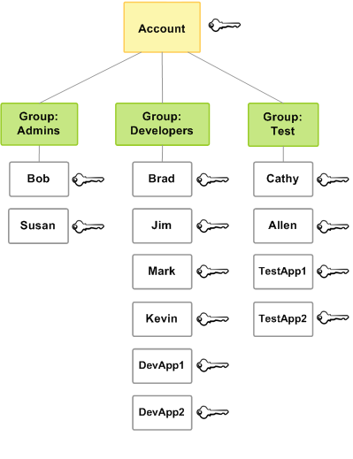

IAM Users
Identity and Access Management
Create Users and Groups
Establish Trust Relationships
Govern Access via Policy Documents

Slide 40















IAM - Instance Profiles
Amazon EC2 Instance
Role: Allow Amazon S3 access but nothing else
Amazon DynamoDB
Amazon S3

Slide 41


IAM – AWS Master Account
AWS Account
Master/Root Account Permissions
Allow by default
MFA
Always treat the master account credentials as if they could launch an ICBM!

Slide 42
AWS Directory Service

Slide 43
Directory Service - Overview
Three types of directory services:
Microsoft AD (Enterprise Edition)
A managed Microsoft Active Directory service running on Windows Server 2012 R2
Highly availability (multi-AZ), patched, and monitored
Automatic daily backups (encrypted)
Can support up to 50,000 users
Fully functional MS AD
Simple AD
Powered by Samba 4 Active Directory
Users and Groups can be created directly in the AWS console
Windows servers can auto-join this domain as they would in an AD environment
Can support 5,000 users
AD Connector
Connect your on-prem AD to your AWS account
Associate AD users/groups with IAM users/groups
Windows servers can auto-join this domain as they would in an AD environment
Manage the AWS console using your AD credentials
49

Slide 44
AWS Compute Overview

Slide 45
Current vs AWS
Now | AWS
Server, VM | Instance
Template, Image, Host Profile | AMI, Instance Type
Hypervisor (usually ESXi, or Hyper-V) | Hypervisor (Xen)
VM Snapshot | Snapshot

Slide 46
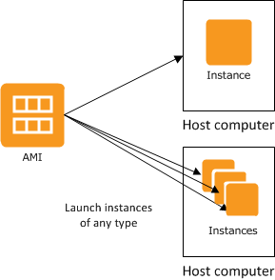

EC2 – Elastic Cloud Compute
AMI
Instances are based on an Amazon Machine Image
You can create new AMIs from a running instance
AMIs are unique to each region

Slide 47
EC2 - Instance Types
Choosing the correct instance type for the required workload
T2 for light weight general purpose – but with burstable performance
M4 for general purpose
R3, X1 for memory and database heavy applications
C3, C4 for compute heavy applications
G2, P2 for GPU intensive applications
I2, D2 for storage heavy applications (random)
HS1 for storage heavy applications (sequential)
Example of M4 family of instance type
Model | vCPU | Mem (GiB) | Dedicated EBS Bandwidth (Mbps)
m4.large | 2 | 8 | 450
m4.xlarge | 4 | 16 | 750
m4.2xlarge | 8 | 32 | 1,000
m4.4xlarge | 16 | 64 | 2,000
m4.10xlarge | 40 | 160 | 4,000
m4.16xlarge | 64 | 256 | 10,000

Slide 48
EC2 - Running Instances
Running instances
Instances are launched into an existing VPC subnet
CloudWatch monitoring is enabled by default
CPU Utilization, Network I/O are the primary data points of interest
Memory and Disk require an additional script that will post a to a custom CloudWatch metric
Status checks
OS check
Network reachability check

Slide 49
EC2 – Instance Recovery
CloudWatch monitors instance
Automatically recovers if it becomes impaired
underlying hardware failure
problem that requires AWS involvement to repair
During instance recovery, the instance is migrated during an instance reboot, and any data that is in-memory is lost

Slide 50
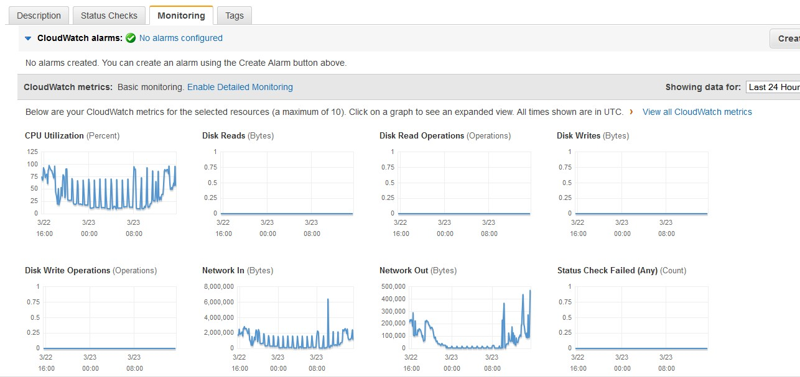
EC2 - Monitoring

Slide 51
EC2 - Bootstrapping
User Data
Provides a hook to inject scripting into any standard instance you decide to launch
These include the Amazon Linux, Windows and Ubuntu AMIs
User Data can only be modified while the instance is stopped
Suggested patterns
Install security updates
yum update -y
Install middleware
yum install -y httpd
chkconfig httpd on
Download and execute a remote script
Assign an IAM Profile to the EC2 instance
Aws s3 cp s3://mybucket/myscript.sh /tmp/myscript.sh
./tmp/myscript.sh

Slide 52
EC2 - Pricing
On Demand Instance
This is the most common and flexible pricing option
Pay only for what you use
Stopped instances will not accrue hourly compute costs
Pay by the instance hour
Reserved Instance (RI)
1 or 3 year commitment
Pay for EC2 hourly at reduced rates (from On Demand rates)
Payment Options
No Upfront payment: no CapEx, lower hourly rate than On Demand
Partial Upfront payment: some CapEx, lower hourly rate than No Upfront
All Upfront payment: larger Capex, lowest hourly rate possible

Slide 53
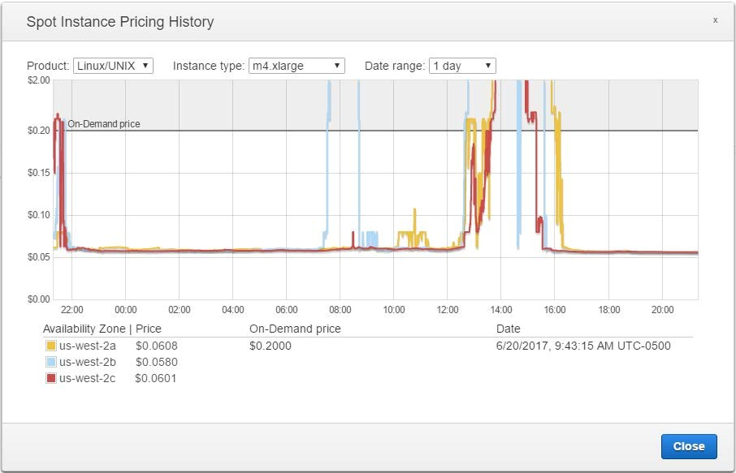
EC2 - Pricing
Spot
Useful for “worker pool” scenarios
o Transcode, map reduce task nodes
Can be lost as soon as someone is willing to pay more for that instance

Slide 54
AWS Elastic Load Balancing

Slide 55
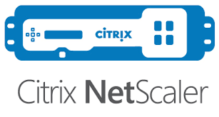
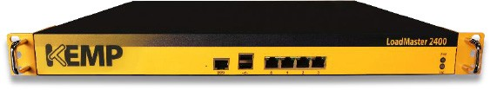

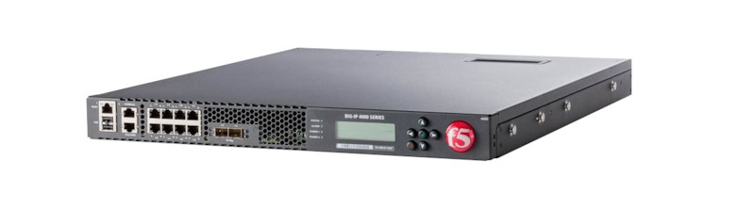
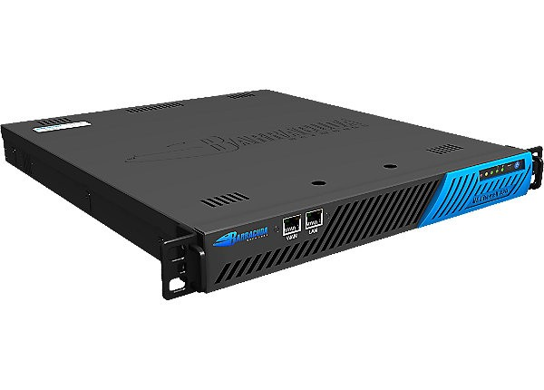
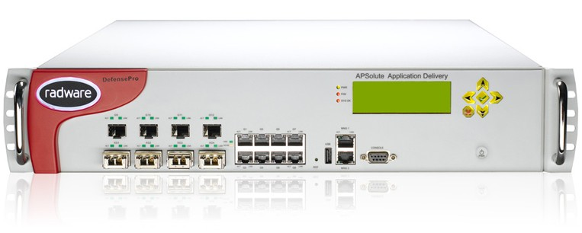
On Premise
AWS
Elastic Load Balancer

Slide 56

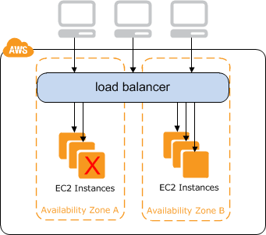
ELB - Elastic Load Balancer
Public Side
Consists of an endpoint which is the equivalent to a traditional VIP
Does not use a static IPv4, but rather an Alias/CNAME
The endpoint will not always resolve to the same IP
Private Side
Minimum of one virtual ELB node per AZ
Certificate Termination
Only one SSL certificate per ELB
Multi-Domain certificates are valid

Slide 57
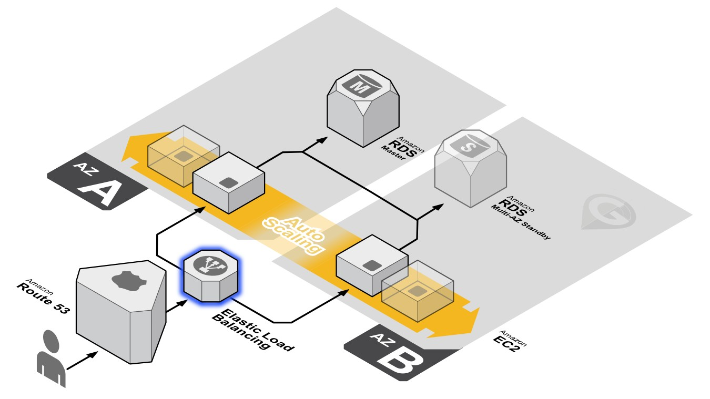
ELB – Spans Multiple Availability Zones

Slide 58
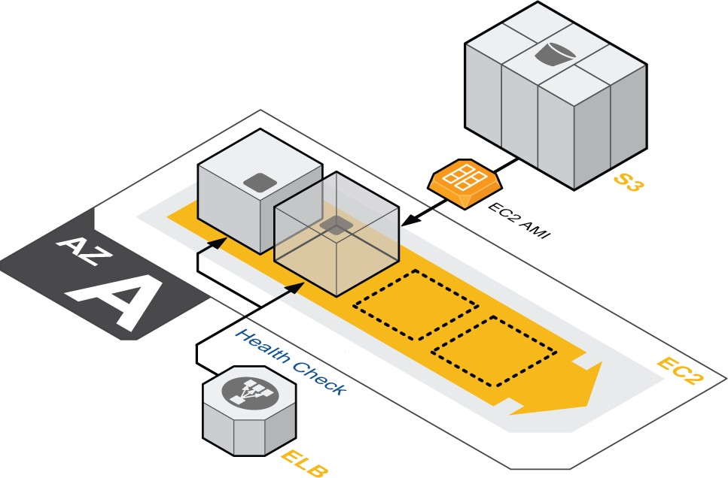
Auto Scaling - Overview
Auto Scaling Key Features
Adds or removes servers based on load
Self-healing pool of resources
Every instance is based on a “gold” master image

Slide 59
Auto Scaling - Components
Auto scaling group
Instance location
Subnet
Load Balancer
Number of instances
Min
Max
Desired
Launch config
Instance details
Size
PEM key
IAM Profile
Security Group(s)
User data

Slide 60
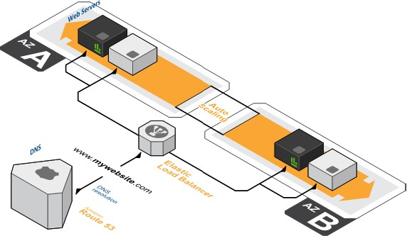
Auto Scaling - Multi-AZ
Multi-AZ Auto Scaling
Highly Available
Production Standard
Spans Datacenters

Slide 61
Auto Scaling - CloudWatch
CloudWatch is the final piece of the auto scaling puzzle. You can create alarms based on instance metrics which trigger auto scaling actions.
Scaling policies Scale up alarm
Execute policy when: CPU is greater than 60%
Take the action: Add 2 instances
And then wait: 10 minutes
Scale down alarm
Execute policy when: CPU is less than 20%
Take the action: Remove 2 instances
And then wait: 10 minutes

Slide 62
AWS Storage Overview

Slide 63
Traditional Platform - Storage Architecture
NAS or Fileserver
/DirShare / 01
File01 File02
/DirShare / 02
File01
Server Head
In the old days…
Hardware acquisition and datacenter space required advanced planning
Disk space and I/O allocation juggling for the entire application lifecycle
Volume and file redundancy not built-in
Capital commitment and refresh budget considerations
SMB / CIFS
/root
C:\
/swap
Pagefile Temp Dir
/app
Program Files
/data
Data
Platform Monitoring Tools
Tape Library
ArchiveVol 01
ArchiveVol 02

Slide 64
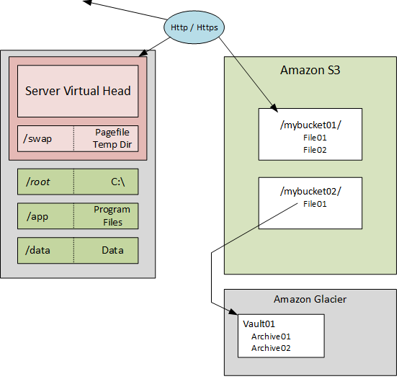
AWS Instance Volumes and Data Storage
The new [improved] way of doing things…
Elastic pay-as-you-go model
Redundancy and snapshot utilities built-in
New APIs and tools simplify application development, administration and data lifecycle management
•
•

Slide 65
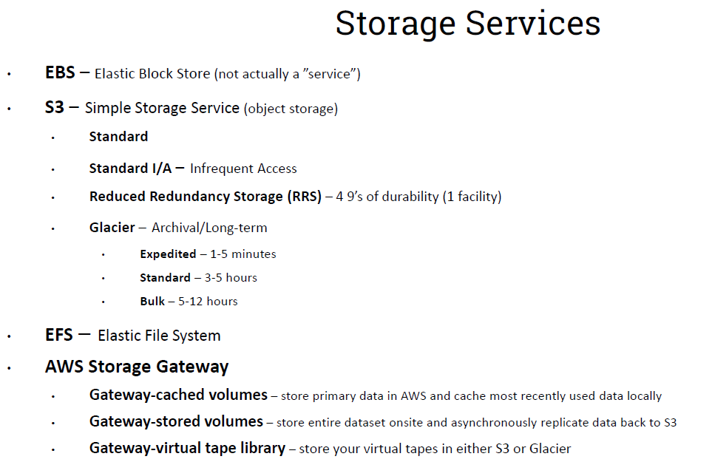

Slide 66
Ephemeral Drives (EC2 Instance Store) Overview
Block device attached to the host machine
Available to server instance
May be mounted and used for temporary storage
No additional usage charges for disk space or I/O
Server Virtual Head
/swap
Pagefile Temp Dir
Not redundant: no built-in RAID or snapshot function
/root C:\
/app
Program Files
Data loss will result if any of the following occur:
/data Data
Host server or instance crash
Instance termination
Disk failure

Slide 67
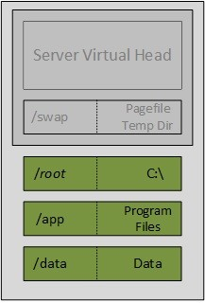
EBS - Elastic Block Store
Block storage ideal for creating versatile OS volumes
Define type, size and optionally I/O capacities [within service limits]
Magnetic, SSD and Provisioned IOPS
Mount to a single instance, similar to local drive
Simplified Encryption options
Volume sizes from 1GiB to 16TiB
Persistent and durable
Redundant copies stored in single AZ
Not permanently bound to a server instance and will survive server crash or shutdown
Snapshot capabilities for point-in-time backups
Resizing and duplicating volumes
Moving across AZs; Exporting across Regions
Performance metrics available through CloudWatch

Slide 68
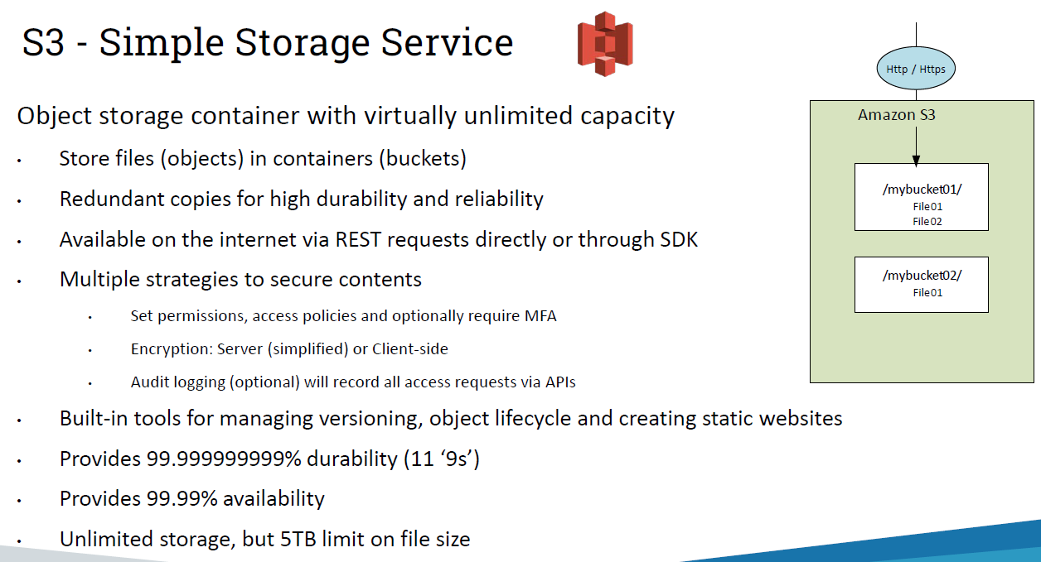

Slide 69

Amazon Glacier - Overview
Storage service optimized for reliable and low cost storage of archive data
Data objects are securely archived, however not immediately accessible
Create vaults (containers) to hold archives (any file based object)
Upload archives programmatically
Submit requests to retrieve archives. Available in about 4 hours
Cost is approximately $.01/GB/Month plus modest API and retrieval charges [if applicable]
Single archive limited to 40TB, but no limit in total amount of storage

Slide 70

EFS – Elastic File System
Fully managed file server storage
Uses NFS (v4.1) protocol
Linux server only, Windows support planned for future release
Can be mounted by 1,000s of EC2s
Can be accessed from on-prem Data Center if using Direct Connect
Highly available, redundant across multiple Azs
Can grow from empty file system to multiple petabytes automatically

Slide 71
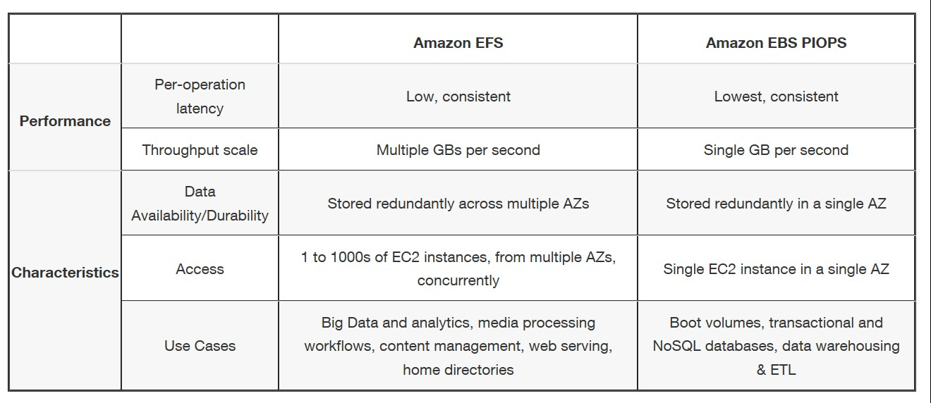
EFS – Comparing EFS and EBS

Slide 72
AWS Database Overview

Slide 73
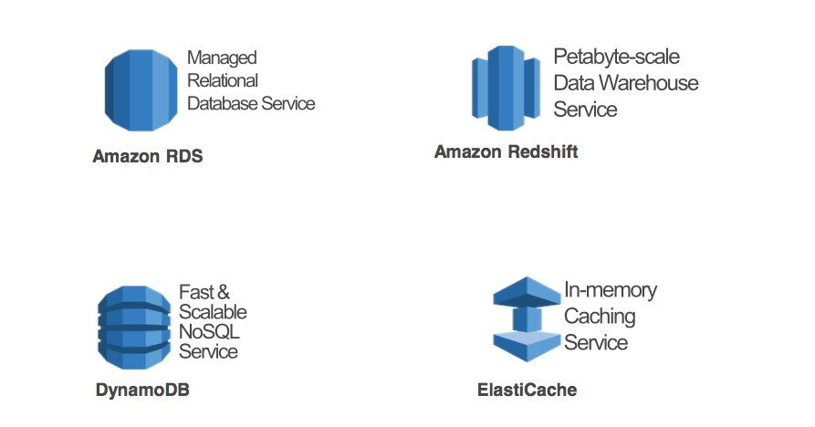
AWS Database Services

Slide 74

Workload Driven Data Store Selection

Slide 75

RDS - Relational Database Service
Fully managed relational database service with the following key advantages:
Amazon manages resource redundancy, software patching, backups, failure detection and recovery
Ability to configure specific resources to cost-effectively scale your application
Pay-as-you-go model offering included license or license portability [see fine print to ensure license compliance]
Streamlined management options to easily configure highly available topologies, create database snapshots and deploy test instances

Slide 76






RDS - Relational Database Service
6 Platforms
Oracle
MS SQL
MySQL
PostgreSQL
MariaDB
Amazon Aurora
Fully managed
Zero admin

Slide 77
AWS Aurora
Fully managed relational database engine that combines the speed and availability of high-end commercial databases with the simplicity and cost effectiveness of open source databases.
Key features:
Architected for 99.99% availability
Automatic failover < 30s (Possible Oracle RAC solution)
Enterprise performance (5x) at 1/10 the cost
Compatible with MySQL and PostgreSQL
Automatically grows storage as needed, up to 64 TB
Easy migration from MySQL
Up to 15 Aurora Replicas in a region
Cross-region replication
Encryption in-transit and at rest
Continuous backup to S3 (11 9’s data durability)
Fully managed

Slide 78

DynamoDB
Fully managed NoSQL database service offering the following key advantages:
Seamless and virtually unlimited scalability conveniently managed automatically by Amazon
Ability to define specific resource allocation limits to ensure predictable performance while containing costs
Easy administration and well-supported development model
Integration with other core Amazon data services (for example Redshift and EMR)

Slide 79

Redshift
Fully managed Enterprise-class data warehouse service offering the following advantages:
High performance, massively parallel columnar storage architecture providing streamlined scalability
Mainstream SQL query syntax allowing for rapid platform adoption
Flexible node type and RI options allowing for workload alignment and cost efficiency
Massively scalable 160 GB -> 1.6 PB

Slide 80

Database Migration Service (DMS)
AWS Database Migration Service helps you migrate databases to AWS easily and securely.
The source database remains fully operational during the migration, minimizing downtime to applications that rely on the database.
Homogenous (Oracle to Oracle) & heterogeneous migrations (ie Oracle to Aurora, or Microsoft SQL Server to MySQL) using Schema Conversion Tool
Can also be used for continuous data replication with high-availability

